Slide 1
Pharmacology of Neurodegenerative diseases
Dr
Nadheerah F Neamah

Slide 2
Progressive loss of selected neurons in discrete brain areas,
resulting in characteristic disorder of movement, cognition, or both Include:
• Alzheimer disease: dementia and disordered cognitive function.
• Parkinson’s disease: a disabling motor impairment disorder.
• Huntington disease: excessive and abnormal movement.
• Amyotrophic lateral sclerosis (ALS): progressive weakness and muscle atrophy.
• Multiple Sclerosis: is an autoimmune inflammatory demyelinating disease of the CNS.

Slide 3
Parkinson’s Disease
Degeneration of neurons within nigrostriatal pathway resulting in loss of dopaminergic activity.
Imbalance of dopaminergic and cholinergic activity within the
extra-pyramidal system, reduced dopaminergic OR Increased cholinergic activity cause an extrapyramidal motor disorder
The aim of treatment eithor Treatment to restore dopaminergic activity OR reduce cholinergic activity
Characterized by
rigidity, akinesia, flat facies, tremor
With secondary manifestations like postural and gait abnormalities
with a tendency to fall backwards or forwards

Slide 4
Treatment
Pharmacologic treatments can only offer temporary relief; they neither reverse nor arrest the disease process
Drug affecting brain dopaminergic system
1. Dopamine precursor: levodopa
2. Peripheral decarboxylase inhibitors: carbidopa, benserazide
3. Dopamine agonists:
-Ergot derivatives: bromocriptine, pergolide, piribedil,
-Non ergot derivatives: ropinirole, pramipexole
4. MAO-B inhibitors: selegiline
5. COMT inhibitors: entacapone, tolcapone
6. Dopamine facilitator: amantadine

Slide 5
Drugs affecting brain cholinergic system
1-Central anticholinergics: trihexyphenidyl (benzhexol), procyclidine,
benztropine, biperidine
2-Antihistaminics: diphenhydramine, promethazine
Dopamine precursor: LEVODOPA
High therapeutic index-drug of choice for symptom control in elderly
Dopamine itself has low bioavailability and does not readily cross the BBB, its precursor, Levodopa, is readily transported into the CNS, and is converted to dopamine in the brain by the enzyme DOPA decarboxylase, which is present in many body tissues.
Levodopa is usually given with carbidopa, a drug that does not cross the BBB but inhibits DOPA decarboxylase in peripheral tissues.

Slide 6
levodopa should be taken on an empty stomach, typically 45 minutes before a meal.
• Because, Ingestion of large, neutral amino acids ‘leucine& isoleucine’ compete with levodopa for absorption from the gut and for transport across the BBB.
CI
In patient with a history of psychosis, Levodopa exacerbates symptoms, possibly through the build up of central amines.
• In patients with glaucoma, the drug can cause an increase in intraocular pressure.
Drug interactions
-Antipsychotic drugs, because these block dopamine receptors and produce a parkinsonian syndrome themselves.

Slide 7
- The vitamin pyridoxine (B6) increases the peripheral breakdown of levodopa and diminishes its effectiveness.
Non selective MAOI, such as phenelzine, which could lead to a life threatening hypertensive crises caused by enhanced catecholamine production.
MAO B Inhibitors: Selegiline
Inhibits Dopamine metabolism by selectively inhibits MAO B (which metabolizes dopamine), but does not inhibit MAO A (which metabolizes norepinephrine and serotonin). Therefore, it enhances the actions of levodopa, selegiline significantly reduces the required dose of levodopa.
Cheese reaction: at recommended doses has little potential for causing hypertensive crisis (Does not cause “cheese reaction”).

Slide 8
However, if selegiline is administered at high doses, the selectivity of the drug is lost, and the patient is at risk for severe hypertensive.
Catechol-o-methyltransferase (COMT) inhibitors
Entacapone and Tolcapone
-nitrocatechol derivatives that selectively and reversibly inhibit COMT.
-Normally, the methylation of levodopa by COMT to 3 O methyl dopa which is a minor pathway for levodopa metabolism.
However when peripheral Dopa Decaroxylase enzyme activity is inhibited by carbidopa, a significant concentration of 3-O methyldopa is formed that competes with levodopa for active transport.
Tolcapone penetrates the BBB and inhibits COMT in the CNS and it has a relatively longer duration of action compared to entacapone.

Slide 9
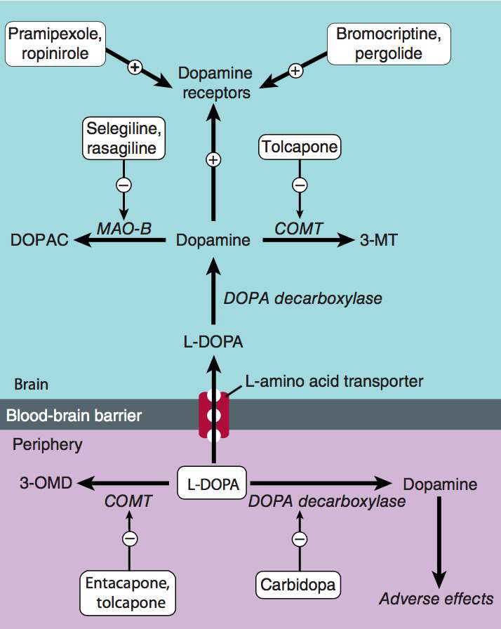

Slide 10
Adverse effects:
• Diarrhoea, postural hypotension, nausea, anorexia, dyskinesia,
hallucinations, and sleep disorders.
• Fulminating hepatic necrosis is associated with Tolcapone.
• Entacapone does not exhibit this toxicity(largely replaced Tolcapone).
Dopamine Receptor Agonists:
Ergot derivatives: bromocriptine (D2) and pergolide (D1 and D2)
These agents have durations of action longer than that of levodopa, thus have been effective in patients exhibiting fluctuations in their response
to levodopa.L-DOPA sparing - useful to delay use of L-DOPA in younger patients
Pergolide is the more potent, while Bromocriptine, in addition to being used to treat Parkinson’s disease, it is the drug of choice to treat cases of hyperprolactiemia

Slide 11
Non ergot derivatives
Pramipexole and Ropinirole
They alleviate the motor deficits in both: patient who have never been treated with levodopa and patients with advanced Parkinson disease taking levodopa.
CI:
Cimetidine, which inhibits renal tubular secretion of organic
bases, increases the half-life of pramipexole by 40%.
Fluoroquinolone antibiotics inhibit the metabolism of ropinirole

Slide 12
Amantadine
Increase the release of dopamine , Blockading cholinergic receptors
Act on NMDA receptors
Compared to L-dopa, Amantadine is less efficacious, tolerance
develops more rapidly and has fewer side effects.
Compared to anticholinergic, Amantadine has little effect on tremor,
but is more effective against rigidity and bradykinesia.
Antimuscarinic agents:
benztropine, Trihexphenidyl (benzhexol), and biperiden
• They are much less efficacious than levodopa and play only an adjuvant role in Parkinsonism therapy.
• SE: Mood changes, xerostomia and visual problems

Slide 13
DRUGS FOR ALZHEIMER’S
Alzheimer’s disease; progressive loss of memory and disordered
cognitive function.
Pathophysiology: Cholinergic transmission decreased in Alzheimer’s,
Treatment Stratigies: current therapies are aimed at:
either improving cholinergic transmission within the CNS
or preventing the excitotoxicity actions of N-methyl-D-aspartate (NMDA)glutamate receptors in selected brain areas.
I. Acetylcholinesterase inhibitors: e.g., Donepezil, rivastigmine, galantamine, Tacrine
Adverse effects – nausea, diarrhea, abdominal cramps, bradycardia, urine incontinence

Slide 14
HUNTINGTON DISEASE
An inherited adult onset neurologic disease due to a single
defect on chromosome 4.
Pathophysiology: excessive dopaminergic activity and diminished GABA functions in the basal ganglia (caudate and putamen).
Characterized by: shuffling gait, stooped posture, resting tremor, speech impediments, movement difficulties, and an eventual slowing of mental processes and dementia
Treatment: Dopamine blockers such as haloperidol or
tetrabenazine are used to treat this disorder.

